Slide 1

Basic Records Management
Secretary of State
State Records Center
440 S 8th Street, Suite 210
Lincoln NE 68508
Notes:
Welcome I would like to thank all of you for attending this Basic Records Management course offered by the Nebraska Secretary of State’s Records Management Division. I would like to introduce our staff that is here and available to help you and I would also like to go around the room and have each person introduce themselves and state which agency they are with and if they are the records officer for that agency.

Slide 2
Overview
Records Management Introduction
Defining Records
Retention Schedules
Preservation of Historical Records
Additional Resources and Services
Notes:
This class provides an overview of the basic information that every State of Nebraska employee needs to know about records management. This class is offered to both state employees and local government employees. This class includes information about Nebraska laws related to records management, it will explain the differences between different types of records, it will introduce Records Retention Schedules, it will address preservation of historical records and provide additional resources that are available about records management topics. We will also touch on the subject of electronic messaging and the rules for retention of these kinds of messages. Next training, we will be devoting the entire class time to the topic of electronic messages.

Slide 3
Learning Objectives
To understand:
  What a record is
  Which records need to be kept
  What a Retention Schedule is
  How schedules help agencies manage their records
Notes:
The objectives of this class are for employees to understand what a record is, which records need to be kept, what a Retention Schedule is, and how schedules help agencies manage their records. This is an interactive class and I ask that if you have any questions during this presentation, please feel free to stop me and we will answer questions as best we can. Please be assured that there are no stupid questions, only stupid answers which puts the pressure back on me.

Slide 4
Origins
The State Records Management Act was first placed into effect during the 1961 Legislative session. It was introduced to follow closely to a “model” prepared by the Council of State Governments and the legislators statement of purpose was: “Recent world events emphasize the necessity of steps insuring the protection and preservation of records which would be essential to continuity of Government, as well as the protection of the personal rights and interests of individual citizens, in the event of any major disaster whether occurring from natural causes or as the result of war”.
Notes:
The Vietnam war was escalating and troop levels tripled in 1961 and again in 1962. Direct American involvement ended in August of 1973. Lawmakers had just undergone the end of the Korean war in 1953 and now were seeing escalation of the Vietnam War. The Cold War was in effect and all in all it was a very unsettling time. The lawmakers in Nebraska were trying to ensure that business in the state would be able to continue and the records would be preserved in these times. Reference Michigan Records Act of 1951. Fire destroyed building after employee started an ash fire from his pipe in a wastebasket to avoid the draft which ultimately caused a three day fire and over $3,000,000 in losses.

Slide 5
Records Management Services
Retention Schedule development, review and approval
Recordkeeping system consulting
Imaging and document management services
Education and training
Records storage services
Notes:
We at Records Management are responsible for the development, review, and approval of records Retention Schedules. We also provide recordkeeping system consulting, imaging and document management services, education and training – like this class, and we provide records storage services. In our records imaging and document management services we are able to handle many different forms of image documenting whether it be microfilm, microfiche, scanning, and other forms of medium.

Slide 6
Our Customers
Executive Branch (Governor's Office and Code and Non code agencies)
Legislative Branch (Unicameral)
Judicial Branch (Supreme Court, Court of Appeals, District Courts, County Courts, Juvenile Courts and Worker’s Comp Court)
Local Governments ( City, County, Villages, School districts, etc.)
Notes:
Who do we at Records Management work with?

Slide 7
Records Analyst Services
Retention Schedules – develop, review and approve
Provide Records Management training
Provide document management services
Provide recordkeeping system consulting
  Filing and storage(paper and electronic)
  Space management (paper and electronic)
  Electronic document management
  Digital imaging
  Micrographic systems
Notes:
Records analysts employed by Records Management are responsible for developing, reviewing, and approving Retention Schedules, and providing training, document management services, and recordkeeping system consulting.

Slide 8
Records Officers - State
Each agency has a Records Officer
Records Officers are appointed by the department director
Responsible for coordinating records management activities of the agency
Agency’s contact person for questions and assistance
Notes:
Each agency in state government has a Records Management Officer who is appointed by their department director. Records Management Officers are responsible for coordinating records management activities for their agency. They are the primary contact person for questions and assistance.

Slide 9
Records Management Principles
If the information is recorded, it is a record
Public records are evidence of government activities
Destruction must be authorized by an approved Retention Schedule
Records must remain accessible and usable for the entire retention period
Every employee who creates, receives or maintains records is responsible for records retention
Notes:
There are certain principles that records management adheres to. First, if any information is recorded on any medium, it is a record. (Any medium ie. Instant messaging, emails, text messages, letters, paper and electronic forms) Public records are evidence of the activities of government. Destruction of records must be authorized by an approved records Retention and Disposal Schedule. Records need to remain accessible and usable for their entire retention period. Storing records on a floppy disk that no longer works with your computer, is not fulfilling your requirements for record retention. Finally, every employee who creates, receives, or maintains records has a responsibility for records retention.

Slide 10
Records Management Act
Neb. Rev. Stat. §§ 84-1201 to 84-1227
Records retention schedules are your only ongoing source for disposing of records (84-1212.02)
Each agency is responsible for having a records officer (84-1207, 84-1207.01)
Each agency is responsible for reporting records disposal to the administrator (Secretary of State) (84-1212.02)
Criminal penalty for willful destruction of government records (Neb. Rev. Stat. §84-1213)

Slide 11


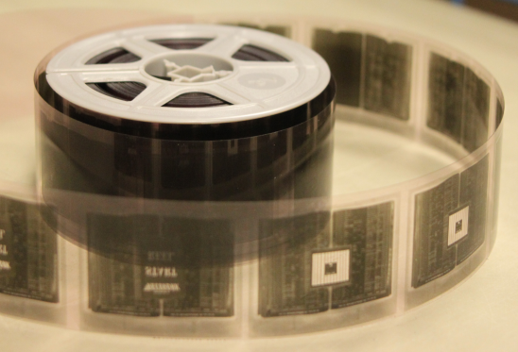

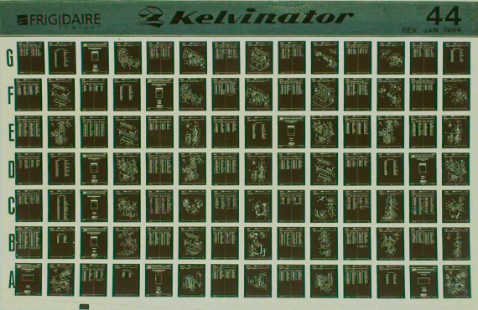
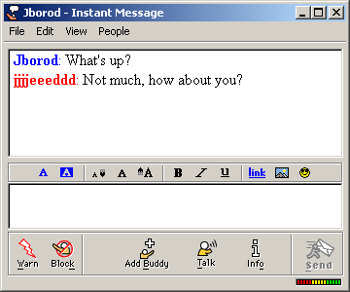
What is a Record?
Paper
Electronic
Microfilm
Text
Microfiche
Instant Message
Notes:
In this section we will explain the differences between different types of records.

Slide 12
Not All Records Are Equal
Records We Keep
  Essential Records
Records We Don’t Keep
  Transitory Records
  Non – record Materials
  Personal Records
Notes:
Not all records are equal. There are some records we need to keep, such as essential records that document government activities. And there are some records we don’t need to keep, such as transitory records, non-record materials and personal records. We will discuss each of these types separately.

Slide 13
Essential Records
“Record means any book, document, paper, photograph, microfilm, sound recording, magnetic storage medium, optical storage medium, or other material regardless of physical form or characteristics created or received pursuant to law, charter, or ordinance or in connection with any other activity relating to or having an effect upon the transaction of public business.”
                §84-1202(4)
Notes:
In accordance with the Records Management Act §84-1202 (7) Essential record means a state or local record which is within one or the other of the following categories and which shall be preserved pursuant to the Records Management Act:
(a) Category A. Records containing information necessary to the operations of government under all conditions, including a period of emergency created by a disaster; or
(b) Category B. Records not within Category A but which contain information necessary to protect the rights and interests of persons or to establish or affirm the powers and duties of state or local governments in the resumption of operations after a disaster;
If it documents the work that you do as a government employee it is an essential record.

Slide 14
Essential Records
Document how you fulfill your job duties
Documents the functions of your agency
Documents the tasks for which you are the designated record keeper
Notes:
Essential records document how you fulfill your job duties, they document the functions of your agency, and they document the tasks for which you are the designated recordkeeper.

Slide 15
Essential Records
Retention is governed by Retention and Disposal Schedules
Examples
  Correspondence with general public, customers/clients, other government employees
  Completed applications
  Data
  Photographic evidence
  Reports of findings or activities
  Work calendars
Notes:
Retention of essential records is governed by Retention and Disposal Schedules, both general and agency specific. Essential records may include correspondence with the general public, customers, clients, other government employees, etc. They may also include completed applications, data, photos, reports of findings, work calendars, etc.

Slide 16
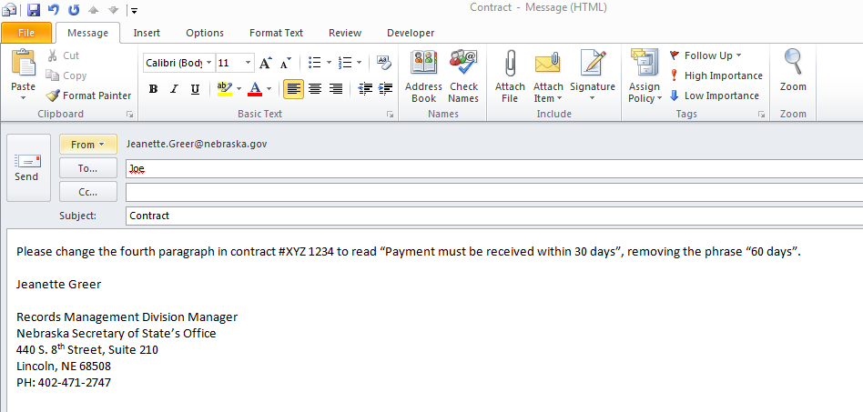
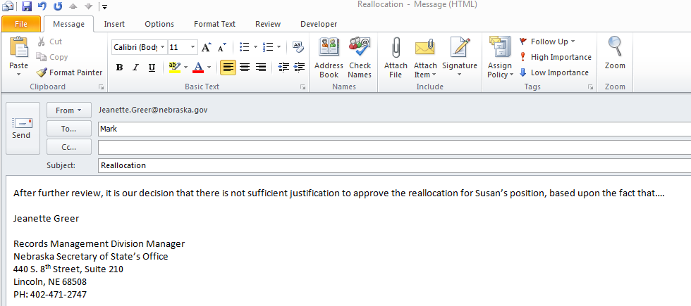
Examples of Essential Records
Notes:
These are examples of essential records. They include directions to include the language of a contract, and decisions on personnel. It is important to note that from this Outlook page an employee may be able to make a decision on retention and build that into their weekly routine for both received and sent emails.

Slide 17
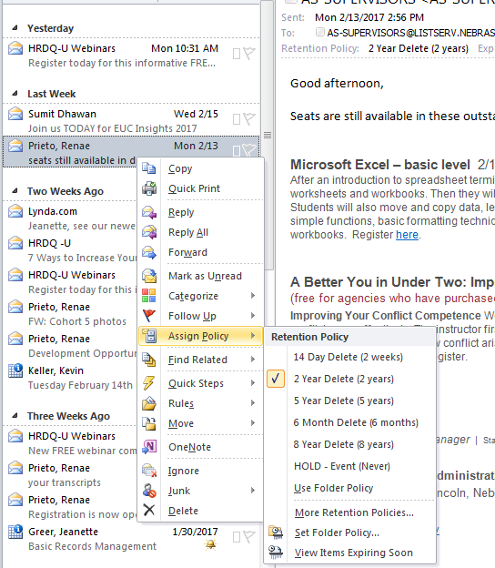
Outlook Retention Policy

Slide 18
Creating Essential Records with Personal Resources
Government business conducted using personal resources creates public records
  Personal e-mail account
  Social media tools (such as Facebook or Twitter)
  Personal cell phones
  Home computer
Subject to Retention and Disposal Schedules, as well as litigation.
Notes:
If you conduct government business using personal resources, the records that are created may be essential government records. If so, they are subject to Retention and Disposal Schedules, as well as Freedom of Information and litigation. Personal resources include personal e-mail accounts, social media tools ( such as Facebook and Twitter), personal cell phones, home computers, etc.

Slide 19
Transitory Records
Examples:
  Records or reminders to do a routine task
  Simple inquiries about policies, office location, hours, etc.
  Information that is published elsewhere, like the internet or a procedure manual
  Temporary documents that are replaced by other records that serve as evidence of the activity
Notes:
Transitory records can be disposed of when the activity is completed.

Slide 20
Non Record Material
Records relating to agency activities that have temporary value and do not need to be retained once their intended purpose has been fulfilled.
Transitory records can be disposed of when activity is completed.
Examples:
  Requests or reminders to do a routine task
  Simple enquiries about policies, office location, hours, etc.
  Information that is published elsewhere, like the internet or a procedure manual
  Temporary documents that are replaced by other records that serve as evidence of the activity
Notes:
Transitory records document work activities, but they have little value once the activity is completed and should be destroyed. For state employees, their retention is governed by schedule 124 -34 COMMUNICATIONS, NONRECORD Communications not related to state government transactions or activities and are not included in another agency specific schedule.
No retention required Also see NONRECORD MATERIAL, item 124-82 NONRECORD MATERIAL The following materials are declared to be nonrecord material, regardless of media on
which they reside:
a. Books, periodicals, newspapers, and catalogues acquired and saved as a general reference resource;
b. Extra copies of documents saved only for convenience or reference for which no action is recorded or taken (i.e. reading files);
c. Identical or convenience copies of reports, memoranda, etc., for which your office was not the originator or the office of record, and which have not been annotated by your office;
d. Stocks of publications, reproduced documents, or other printed materials preserved for supply purposes;
e. Blank forms;
f. Junk mail, spam, tickler files "to-do" and task lists that serve as a reminder that an action is required on a given date or that a reply to action is expected;
g. Materials received documenting employee fringe activities (carpool locators, employee recreation and welfare activities, blood donors, charitable funds, community notices, holiday and social meetings, etc.).
NONRECORD MATERIAL may be destroyed at any time by the agency Neb. Rev. Stat. § 84-1215
No RECORDS DISPOSITION REPORT is required

Slide 21
More Non Record Material
Drafts that are replaced by new or final versions
Duplicates
  Agencies can decide which format to use for retaining their records, if records exist in multiple formats
  If multiple offices posses the same record, they should communicate with each other about who is responsible for record retention
Notes:
Drafts that are replaced by newer or final versions, and duplicates. If records exist in multiple formats (such as paper and electronic), agencies can decide which format to use for retaining their records, they don’t have to keep both. If multiple offices possess the same record, they should communicate with each other about who is responsible for record retention, so they don’t keep duplicate copies.

Slide 22
Personal Records
Records that document non – government business or activities
Document your personal life
  Employee Benefits
  Personal financial accounts
  Social events with co-workers, friends, etc.
  Personal purchases and shopping
Store personal records so they are physically separated from government records
Personal records should not be created and stored using state resources
Notes:
Personal records document your personal life, including employee benefits, personal financial accounts, health, family, social events with co-workers and friends, personal purchases and shopping, photos, videos, music, etc. They should be stored separately from government records, using non-government resources.

Slide 23
Use of State Resources
NITC 7-101: Acceptable Use Policy
1. Purpose and Intent
2. Acceptable Uses
The following are acceptable uses of the State Communications System.
2.1
For the conduct of state business.
2.2
For state government sponsored activities.
2.3
For use by state employees and officials for emails, text messaging, local calls, and long-distance calls to children at home, teachers, doctors, daycare centers, baby-sitters, family members, or others to inform them of unexpected schedule changes, and for other essential personal business. Any such use for essential personal business shall be kept to a minimum and shall not interfere with the conduct of state business. A state employee or official shall be responsible for payment or reimbursement of charges, if any, that directly result from any such communication. [Neb. Rev. Stat. § 81-1120.27(1)]
Notes:
Now that you understand the different types of records, it is important to understand how long records need to be kept.

Slide 24
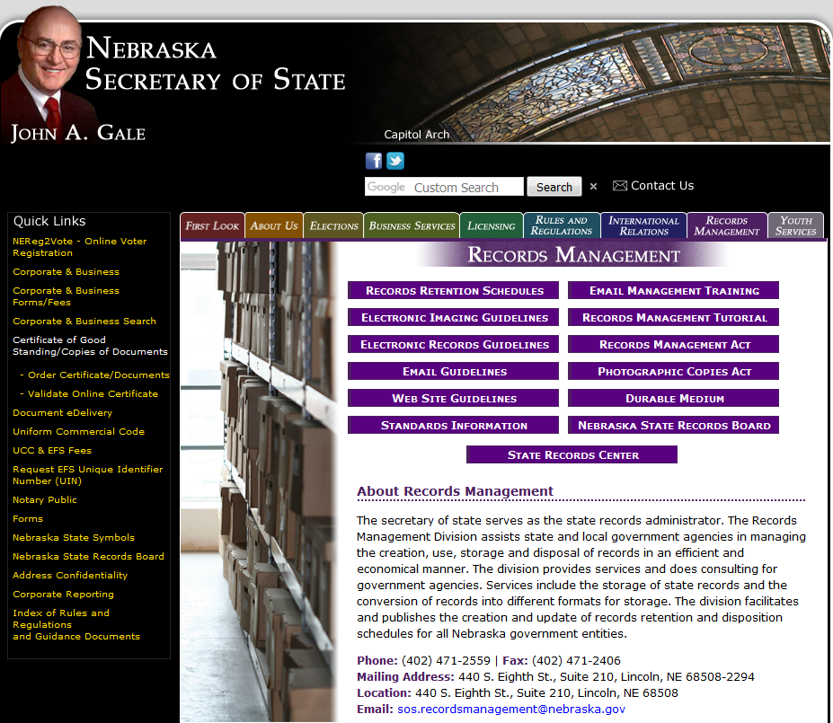
Retention Schedules
Foundation of Records Management
Notes:
Records Retention and Disposal Schedules are the foundation of records management, because all other decisions about how to manage records depends in part upon how long the records are kept. Records Retention Schedules are available by Agency on the Secretary of State’s website. The General Schedule 124 is also on the website.

Slide 25
Retention Schedules
List records created and maintained by agency
Defines the retention period for records
Provide a legal authorization for destruction
Cover all records, in all formats
Should reflect current organization structure and business policies
Notes:
Schedules list the records series that are created and maintained by an agency. They define the retention period for records, and they authorize the destruction of records. Records not listed on a schedule are by default permanent, because there is no authorization to destroy them. Schedules must cover all records, in all formats. There are several misconceptions about Retention and Disposal schedules. First, some people think that schedules only need to cover records that are stored at the State Records Center; this is not correct. Second, some people think that electronic records (like databases and spreadsheets) do not need to be covered on schedules, because storage is unlimited and cheap; this is not correct. Third, some people think that if a record is not listed on a schedule they can make their own decision about how long to keep it; this is not correct. Schedules provide the authorization to destroy records, so they must cover everything. In addition, schedules need to reflect current organization structures and business processes of each agency, so the schedule is accurate and useful.

Slide 26
Retention Schedules
Retention of a record is based upon its administrative, legal, historical or fiscal value (Neb. Rev. Stat. §84-1206(1)(c))
Retention schedules serve as your guideline for storing and disposing of records, regardless of the media on which they reside
Consult your agency specific schedule first, then consult the general records schedule (124 for state agencies/24 for local government agencies)
Records not listed on a retention schedule-may request disposal by submitting list of records to the administrator (Secretary of State) to be referred to the State Records Board (Neb. Rev. Stat. §84-1214)
  Recommended action would be to update schedule

Slide 27

Schedule Approval Process
Approved schedules are legal documents
Schedules are approved by:
  Agency representative
  Records Management Analyst
  Nebraska State Archivist
  Nebraska State Auditor
  Secretary of State – State Records Administrator
Notes:
All schedules are reviewed and approved by an agency representative (usually the agency director), then Records Management Services facilitates the process of sending to the State Archivist and the State Auditor for approval. After each of these positions has signed off on the retention schedule, the Secretary of State as the State Records Administrator gives the final approval and their approval date is the effective legal date of the document.

Slide 28
Determining Retention Periods
Keep records as long as they have:
  Operational/Administrative Value
  Fiscal Value
  Legal Value
  Historical/Archival Value
  Destroy records when their value ceases to exist
Notes:
How do we determine what is the appropriate retention period for a record? First, we look at the record’s administrative value to determine how long the agency needs the record to support it’s daily work activities. Next, we look at the record’s fiscal value to determine how long it is needed to close financial accounts and support auditing. Next, we look at the record’s legal value to ensure that records are kept as long as they are needed as evidence to document compliance with legal requirements. There are a lot of state and federal laws that tell us we have to create records. Rarely, do they tell us how long to keep the records after they are created. However, laws have to be consulted to determine if they define a retention period for various records. Finally, we look at whether the record should be preserved permanently to document the history of the State of Nebraska. Then we set a retention period for when all of these values cease to exist. The most common answer I have found as to how long records should be retained is , “It depends.”

Slide 29
Why follow a Retention Schedule?
Risks associated with keeping records too long
  Wastes space
  Harder to find records you need
  Records must be reviewed for transparency and litigation
  Risks associated with destroying records too soon
  Violation of laws
    Exposes agency to liability if records are requested via auditing, litigation, etc.
  Avoid random record purging by establishing a routine within the normal course of business for destroying records.
Notes:
Why is it important to follow a retention schedule? There are risks associated with keeping records too long: they waste space, they make it harder to find records you need, and the records must be reviewed for Freedom of Information Act information, audits, and litigation requests. This includes non-records and transitory records that you have chosen to retain. There are also risks associated with destroying records too soon: it is a violation on Nebraska State Law,

Slide 30
Freedom of Information Act
FOIA allows the public to request copies of government records
Immediately cease all destruction of relevant records when a request is received
Contact Agency Head, Records Officer and IT staff immediately
Agency Head will determine what is released
If records are destroyed on a regular basis (in accordance with approved Retention and Disposal Schedules), they may no longer exist when a FOIA request is received
Notes:
The Freedom of Information Act (FOIA) allows the public to request copies of government records. Some records are exempt from disclosure. Agencies need to immediately cease all destruction of relevant records when request is received. It is important to notify information technology staff about relevant electronic records, so they can protect them from deletion until the request is filled. If a record still exists when a FOIA request is received, it must be evaluated by the Agency Head for release. This process is time consuming, labor intensive, and expensive. Fees may or may not be charged but regardless most fees are not sufficient to cover the total costs of retrieving the records. Time spent responding to requests is time lost for regular duties. Only authorized people should release records to requestors. However, if records are destroyed on a regular basis ( in accordance with an approved Retention and Disposal Schedule) they may no longer exist when a request is received.

Slide 31
Litigation
Parties to a lawsuit can request records they consider to be relevant evidence to the case
Immediately cease all destruction of relevant records when litigation is anticipated
Contact Agency Head and information technology staff immediately
Legal counsel or Department of Attorney General will determine what is released
If records are destroyed on a regular basis (in accordance with approved Retention and Disposal Schedules), they may no longer exist when a litigation hold notice is received
Notes:
During litigation, parties can request copies of records they consider to be relevant evidence to the case. These requests are called a litigation hold notice or discovery hold notice. Records that are exempt from disclosure under FOIA or other laws could be admitted as evidence for litigation. This is a decision that is negotiated between the lawyers and the judge in the case. Agencies need to immediately cease all destruction of relevant records when litigation is imminent. They do not want to be charged with destroying evidence. It is important that agencies notify IT staff about relevant electronic records, so they can protect them from deletion until the case is closed. If a requested record still exists when a litigation hold notice is received, it must be evaluated by legal counsel for release. Again, this process is time consuming, labor intensive and expensive. Most litigation costs cannot be recovered. The time spent responding to litigation is time lost for regular duties. Only authorized people should release records for litigation. Again, if records are destroyed 9in accordance with approved Retention and Disposal Schedules) they may no longer exist when a litigation hold notice is received. Agencies should contact their legal counsel for additional information on litigation holds policies and procedures for individual agencies.

Slide 32
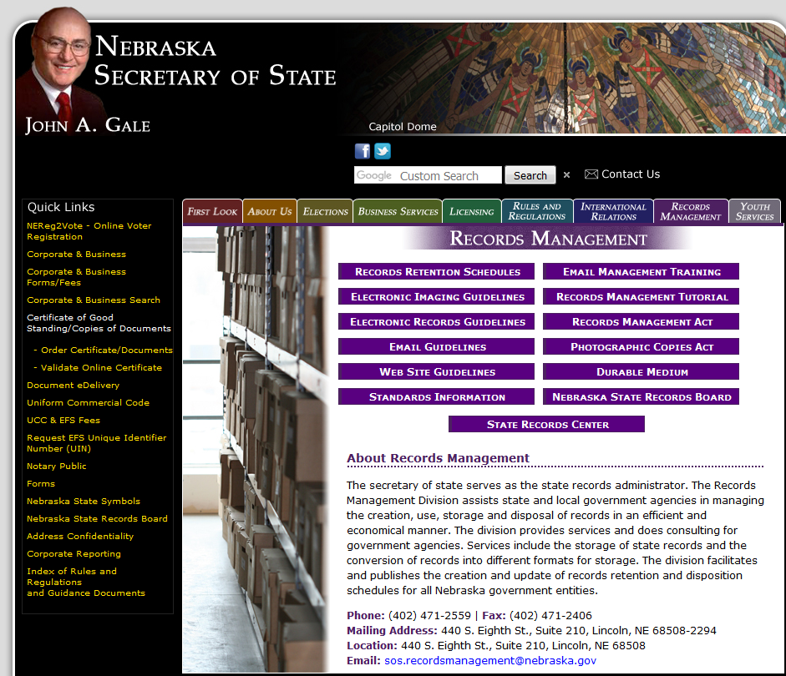
Records Retention Schedules
Notes:
This is where to find Records Retention Schedules. They are located on the Secretary of State’s website under the Records Management tab.

Slide 33
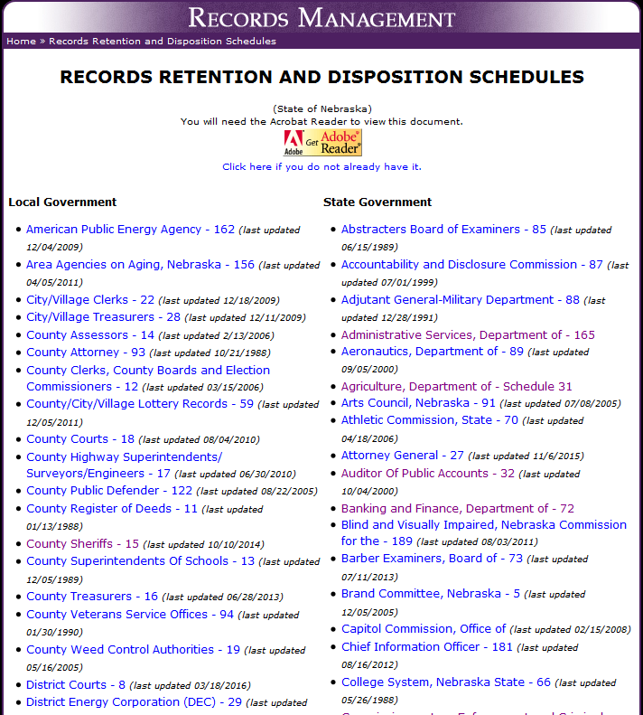
Schedules
Notes:
Once you click on Records Retention Schedules, this listing will appear. On the left hand side there are all of the approved retention schedules for local governments, and on the right hand side are all of the approved schedules for state government, you can find your individual agency and there is also a listing for schedule 124 which is the general records for State Agencies.

Slide 34
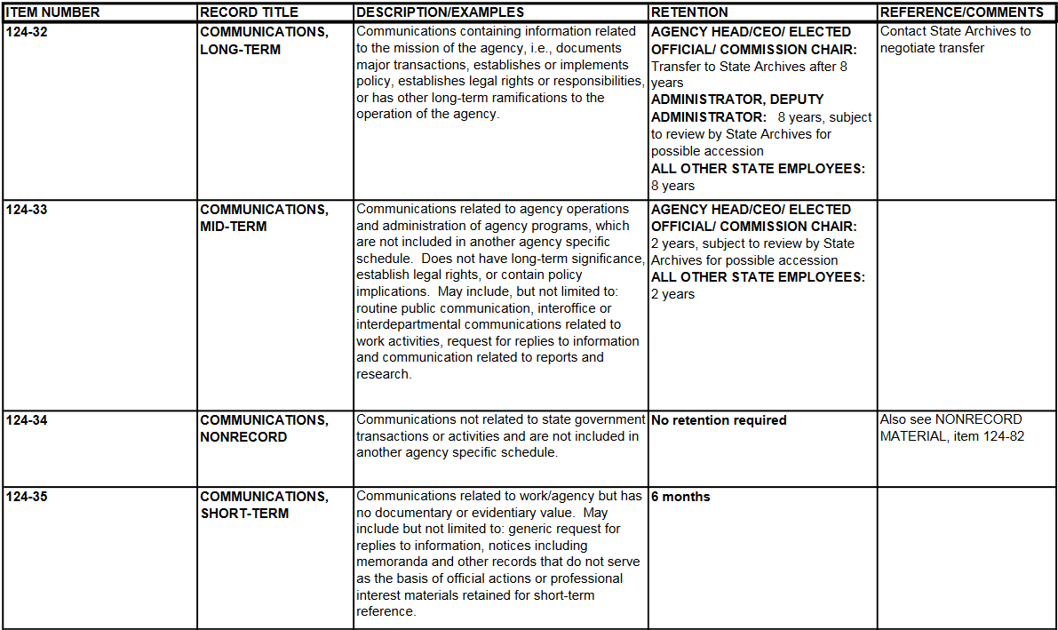
Records Retention Schedules
Notes:
Schedules can be confusing to read. On the screen is an screen shot of Schedule 124 (General Records for all State Agencies) and it is the portion of 124 that covers some of the series concerning communications. On the left hand side in Column 1 is the schedule number. This is a unique number that is assigned to each record series. Columns 2 and 3 contains the series title and description. Column 4 is the Retention Period. This identifies how long the record will be maintained and identifies who the retention schedule is applicable to and what the process is for retention. If you look at 124-32 which refers to long term communications, you will see that communications that establishes or implements policies that is generated by an Agency Head/CEO/Elected Official/ or Commission Chair needs to be retained for 8 years and then transferred to State Archives. The communications generated by an Administrator or Deputy Administrator needs to be retained for the same 8 years but at the end of the retention policy, it needs to be reviewed by State Archives for possible transfer and all other state employees needs to be retained for 8 years and then can be disposed of. The same record series has a little bit different way to handle the record.

Slide 35
Agency Specific Schedules
Cover records that are unique to the agency
Cover records not listed on general schedule
Specific schedules override general schedules when records are listed on both
Retention periods are absolute minimums and maximums
May identify the format of a record
Published on the Secretary of State website
Notes:
Agency – specific schedules cover records that are mot listed on the general schedule because of the unique functions of the agency named on the document. Specific schedules always override general schedules when a record is listed on both, because the agency needs a different retention period. The approving agencies and the public expect agencies to follow their schedules and destroy records in accordance with the approved retention periods. Specific schedules may identify the format of a record, ie: electronic, microfilm, digital, etc. Specific schedules and the general schedule are available on the Secretary of State’s website.

Slide 36
Updating your Retention Schedule
It is the responsibility of the agency to periodically update their retention schedule
Staff at the State Records Center is available to assist in this process
Review your agency specific schedule every year
-Legislation changes
-Policy changes
-Technology changes
Need to have subject matter experts, technology experts, executives, and legal involved in your retention program

Slide 37
Applying Retention
All records need to be reviewed regularly
Identify which records to keep and which to destroy
  Records stored at the State Records Center are evaluated and staff will work with agencies on disposal quarterly
  Agency Directors must designate a records officer to ensure compliance with schedules
  Applying retention saves space (physical and electronic), saves money, and improves retrieval of information.
Notes:
Retention and Disposal Schedules can help and protect agencies, but they are only useful if the agency uses them. Agencies need to review all records (paper and electronic) regularly (for example, monthly or quarterly) to identify which to keep and which to destroy. Records kept at the State Records Center are evaluated quarterly and disposal notices are sent out for agencies to review and decide on which records they want to retain past the disposal date. When the disposal notice is sent out, it may be a good time to trigger the agency to look at records stored within make a retention decision on those records as well. The Records Management division does not audit agencies to confirm compliance with Retention and Disposal Schedules – it is the agency’s responsibility. Applying retention saves space (physical and electronic), saves money, and improves retrieval of information. Physical space within an agency costs the agency money the same as electronic space, but it is not a charge to your monthly bill, only a loss of use of the space occupied.

Slide 38


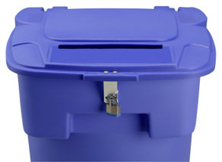
Destroy Records Appropriately
Trash: Used for materials that are not records
  Material is sent to an open landfill
  Recycling: used for records that do not contain confidential or sensitive information
    Material is not destroyed until it is re-purposed at the paper mill
    Confidential Destruction: used to prevent inappropriate release or re-construction of material
      Materiel is on site security shredded
Notes:
It is important that records be destroyed using appropriate methods. There are three primary methods for destroying records. They include the trash, recycling and confidential destruction. Trash should only be used for materials that are not records, like banana peels. Recycling does not protect confidential information. However confidential destruction ensures that confidential information is not accessed inappropriately. All agencies should have locked containers for confidential records that have on site secured shredding.

Slide 39
Tip : Know Your Records
There are a lot of Retention Schedules
  You don’t have to memorize them!!
  Most employees work with only a few record series on a regular basis
  Learn where to find the retention schedules for the records you are responsible for regularly
Notes:
There are a lot of Retention and Disposal and it would be difficult and intimidating to try to memorize them all. The good news is that you don’t have to. They are all available on the secretary of State’s website. Most employees only work with a few record series on a regular basis. If you know which business processes you are responsible for retaining records of, then you can learn the retention periods or look them up. Don\’t worry about the rest unless your recordkeeping responsibilities change. As always, the State Record Center staff is available to help you and the most frequent response that you will get from us is “It depends” But we will try to help you to find the path to the correct answer.

Slide 40

State Archives:
Records Management
Gayla Koerting
State Archivist
&
Curator of Government Records

Slide 41
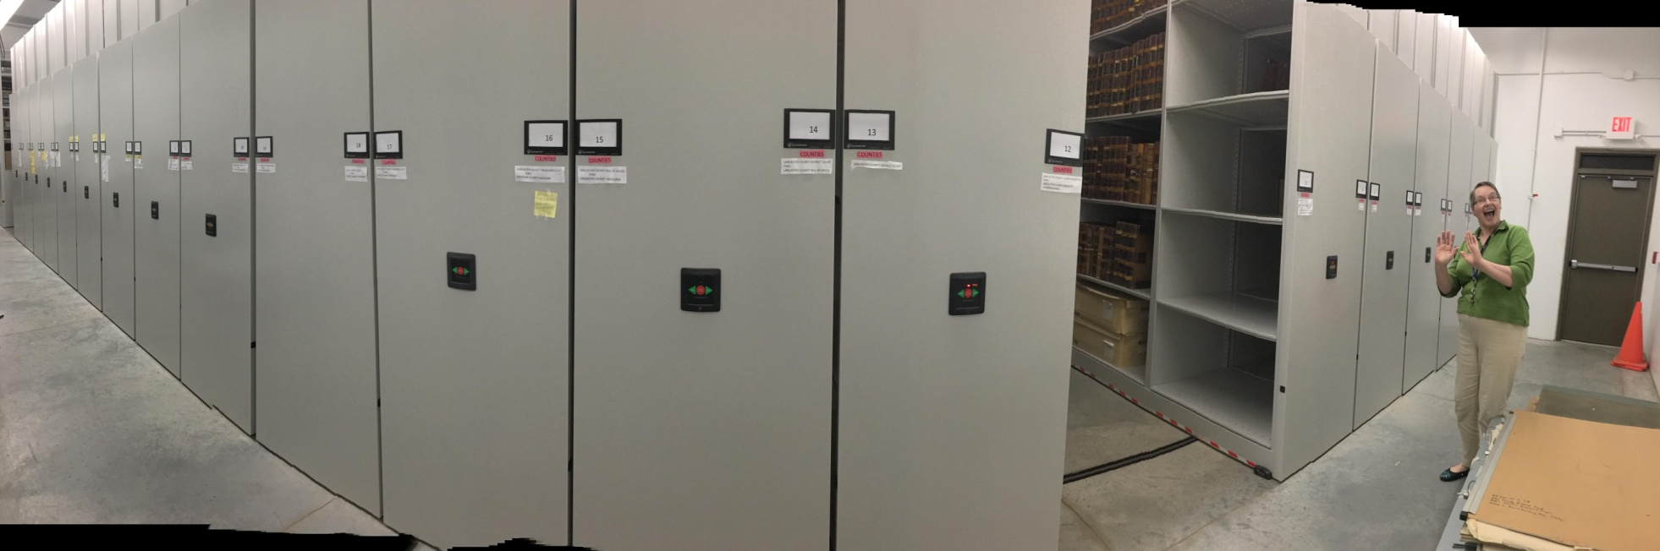
New Govt. Records Facility:
Collections Area of the State Archives:
Happy, Happy, Happy!

Slide 42
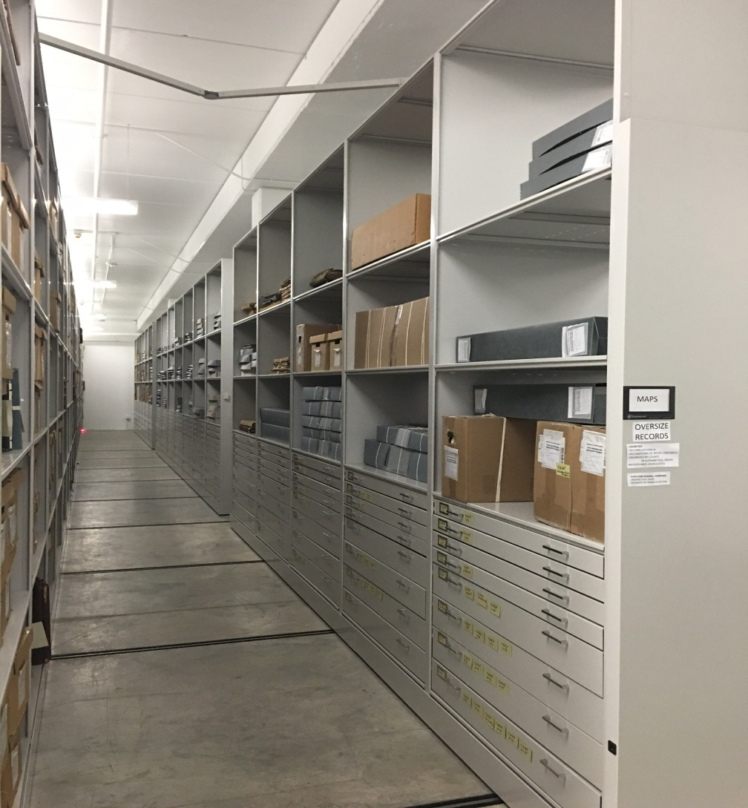
Govt. Records: OV. Storage

Slide 43
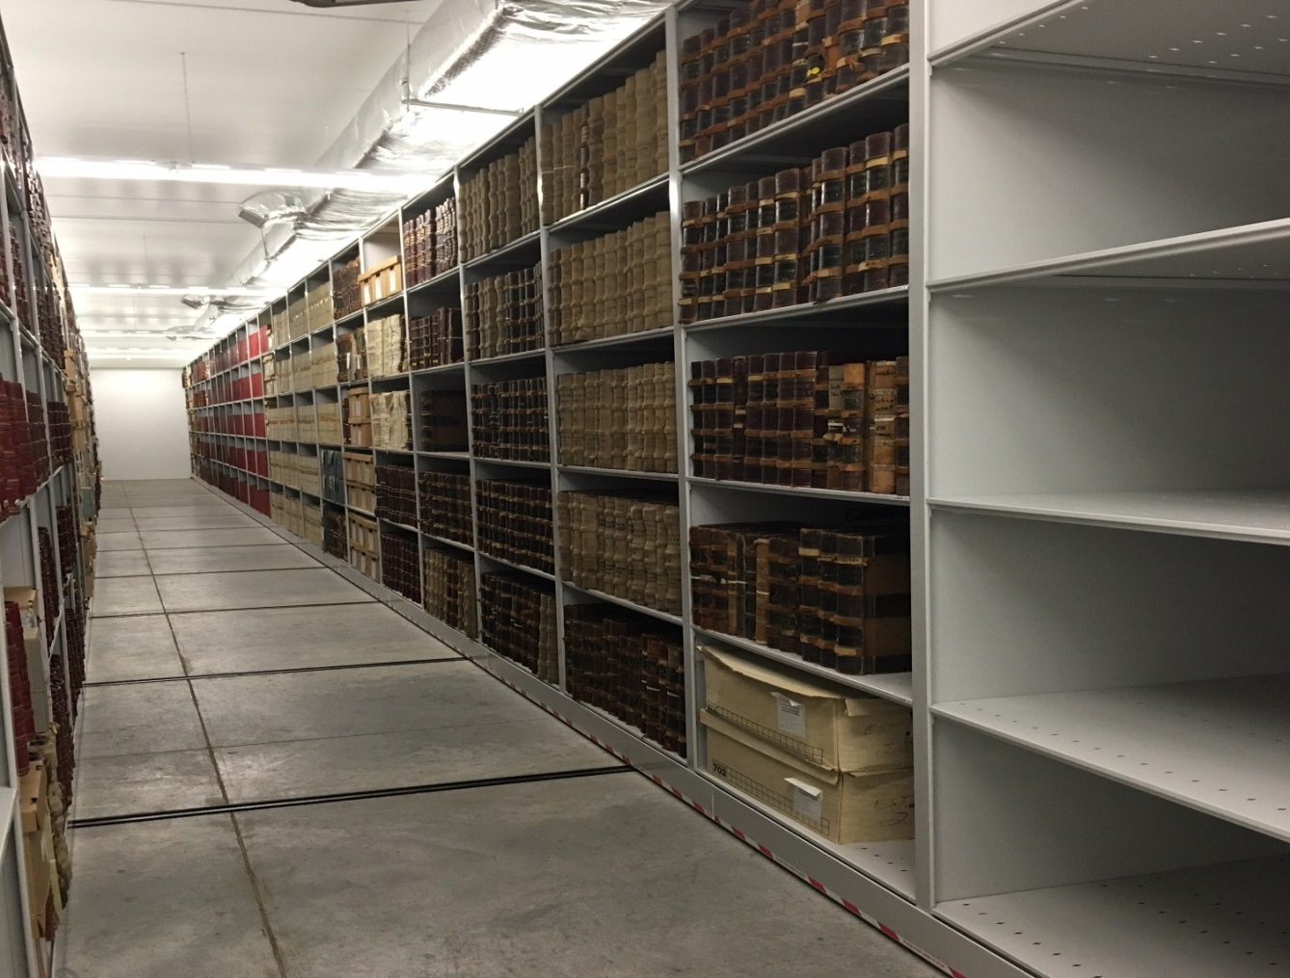
Govt. Records Compact Shelving

Slide 44
Government Records: Authority
Nebr. Rev. Statute: 82-104
The NSHS shall be the custodian of all public records documents, relics, and other material which the society may consider to be of historic value or interest, and which may be in any of the offices or vaults of the several departments of the state, in any of the institutions which receive appropriations of money from the Legislature of Nebraska, or in any county courthouses, city halls, or other public buildings within the State of Nebraska.
.

Slide 45
Authority Cont’d
NOTE: Once records are officially transferred and accepted into the collections of the Govt. Record facility, these records belong under the custody, control, supervision, and management of NSHS/State Archives.

Slide 46
Govt. Records, Past Misconception
Perceived as a “storage facility” for “old files.” Transferred permanent and temporary files to State Archives/Govt. Records
Did not understand that State Archives took custodianship of the records per stat.
No longer feasible from a core mission, labor, and cost perspective

Slide 47
NOTE: 1) A state or county agency may have permanent retention on a record due to audit, legal, or statutory mandate(s)-- does not mean that the State Archives wants to maintain this record in our collections
(Two “permanents” in the schedules)
2) Govt. Agencies—less than 15% of
records produced will be transferred
to State Archives

Slide 48
Additional Resources and Services
Records Management staff are available to conduct classes to agencies or organizations as needed
We are working on have an on line class available
Meetings (feedback here is critical)
  Would you like to see monthly or quarterly meeting
  Topics of discussion
Notes:
Records Management offers free records management training to state employees. Please coordinate with staff if you would like a training session for your agency. On line classes should be available soon. Feedback is appreciated at this time for you to tell us how often you would like to meet whether it is quarterly or monthly and what other topics you would like to see. The next training session will be on email records and two other topics that I forsee training to be on will be durable medium and I am planning a breakout work session with staff available to work with agencies on updating retention schedules. Any other suggestions would be welcome.

Slide 49
State Records Center
Provides for the storage of inactive records
Building has fire and theft protection
Records remain the property of creating agency
Records can only be accessed by authorized employees
Records are transported by our professional staff and can be accessed using our State Records Center software
Notes:
Records Management Services operates the State Records Center for state agencies. The facility provides for the storage of inactive records. The State Records Center uses the Records Center database for ease of transfer and storage of state records. All records stored at the facility remain the property of the creating agency and con only be accessed by authorized employees.

Slide 50
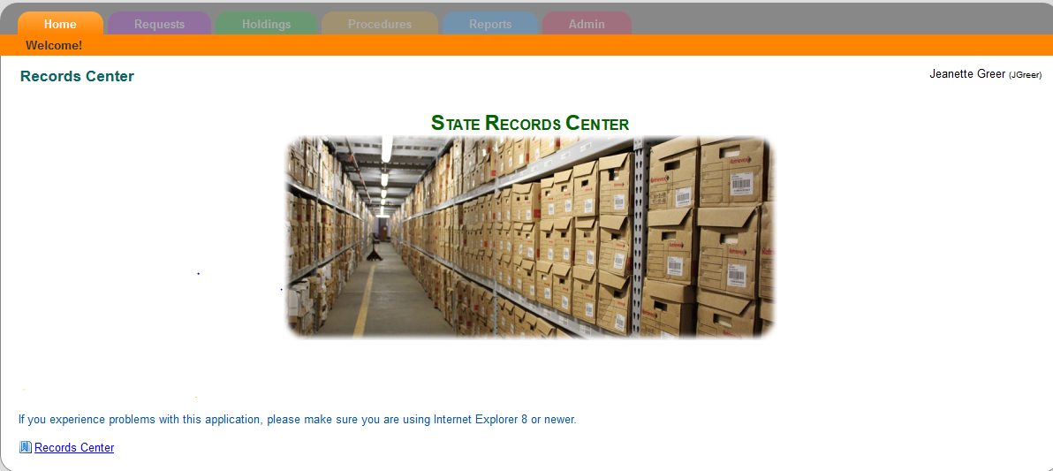
State Records Center

Slide 51
We can help!!
Secretary of State
Records Management Division
440 S. 8th Street, Suite 210
Lincoln NE 68508
(402) 471-2559
http://www.sos.ne.gov/dyindex.html
Notes:
Please contact Records Management Services if you need assistance with records retention, schedules, record keeping systems, imaging needs, or other records management issues. Please feel free to talk with any of us after this class to discuss any needs that you might have and how we may be of assistance. Please also fill out the evaluation sheet and let us know if you have any comments or suggestions going forward. Thank you so much for your time today and we hope to see you at future meetings.

